Slide 1
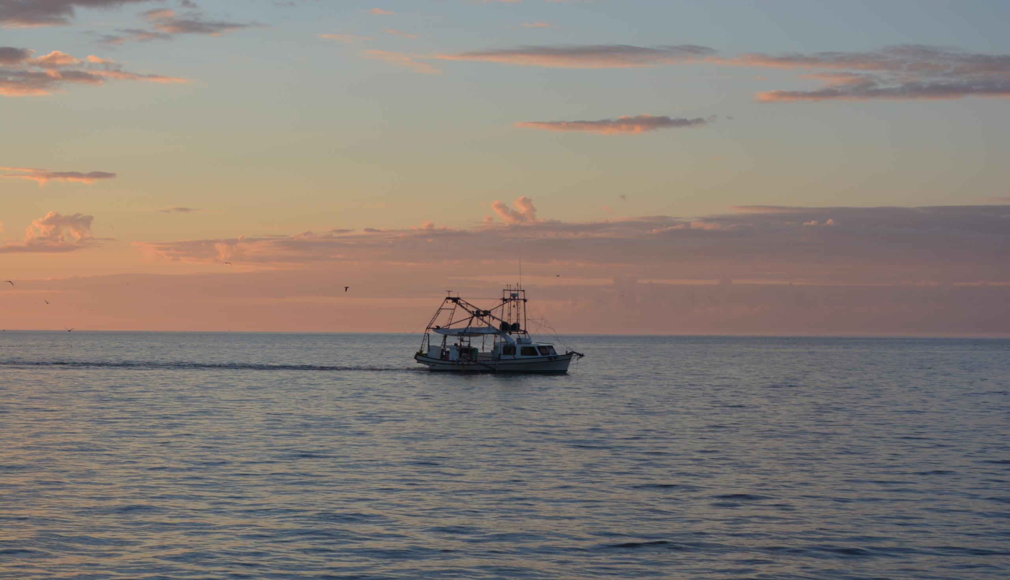


ADVANCING the Seafood Industry
Engaging commercial fisheries through professionalism and marketing
Notes:
The town of Delcambre’s rise from ruin is the ultimate come-back kid story. Dubbed the ‘town too smart to die’, our waterfront community overcame great odds to envision a future greater than before.

Slide 2
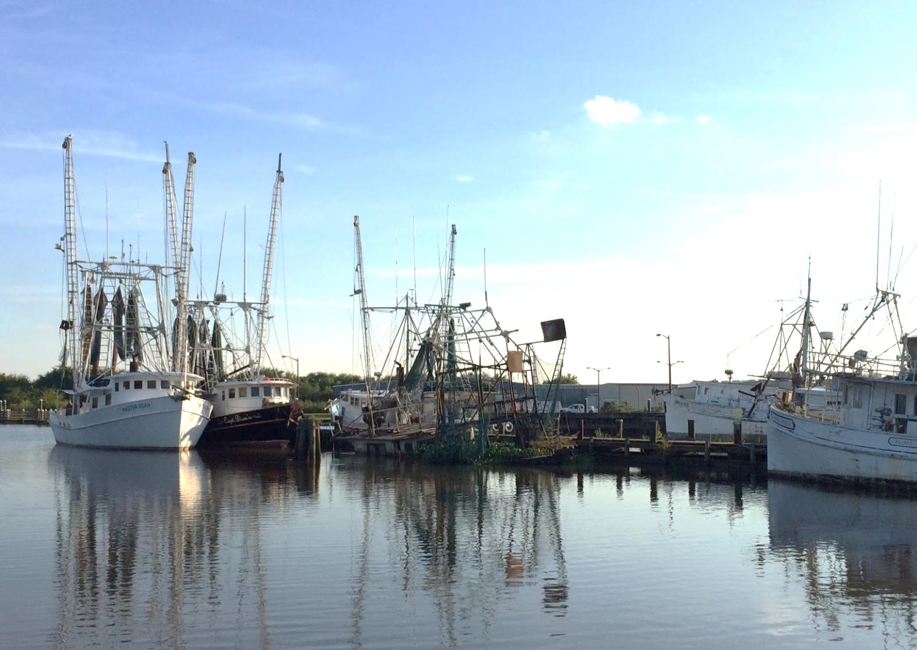

Slide 3
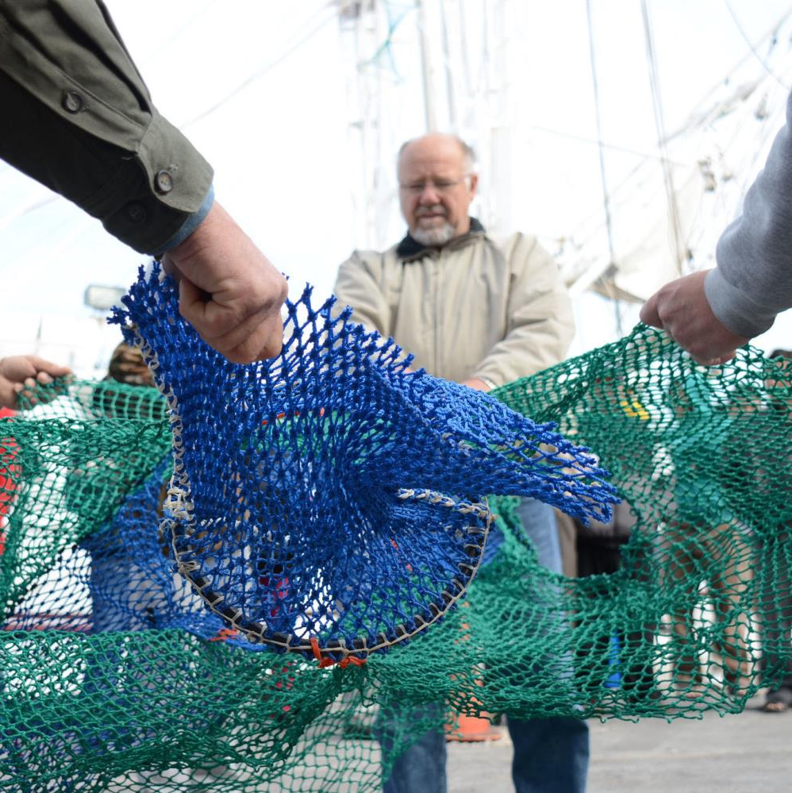



Enter Louisiana Fisheries Forward
Overall Goal
To improve the economic viability and resource stewardship of Louisiana’s commercial fishing industry.
2013

Slide 4
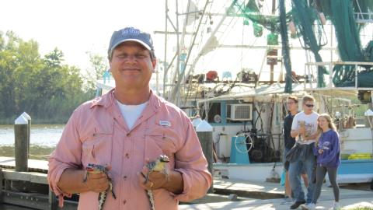
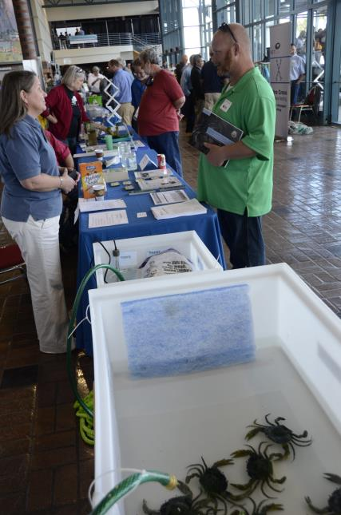
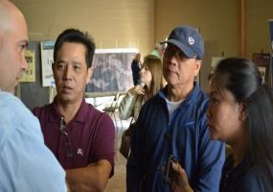
Three-way
interactions
Outreach
Compliance
Rule changes
Rapid response
Extension
Gear training
Quality handling
Safety & sustainability
Engagement: what industry needs?
TEDs training
Water bottom access

Slide 5
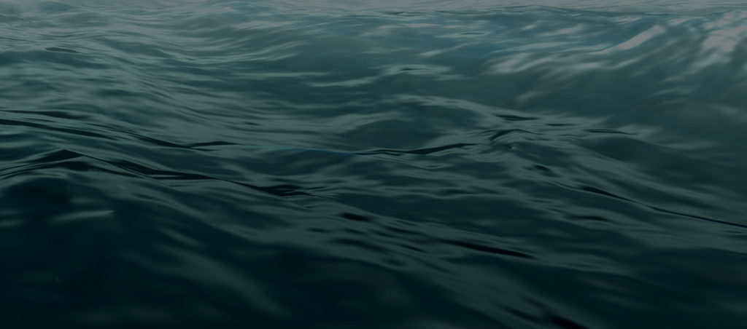
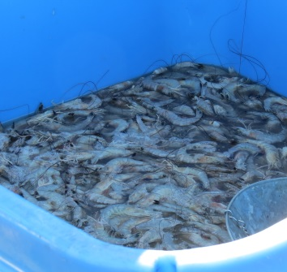
Pieces of the Puzzle
Website
Fact Sheets
Summits
Dock Days
Workshops
Video Series
Existing Trust and Relationships

Slide 6
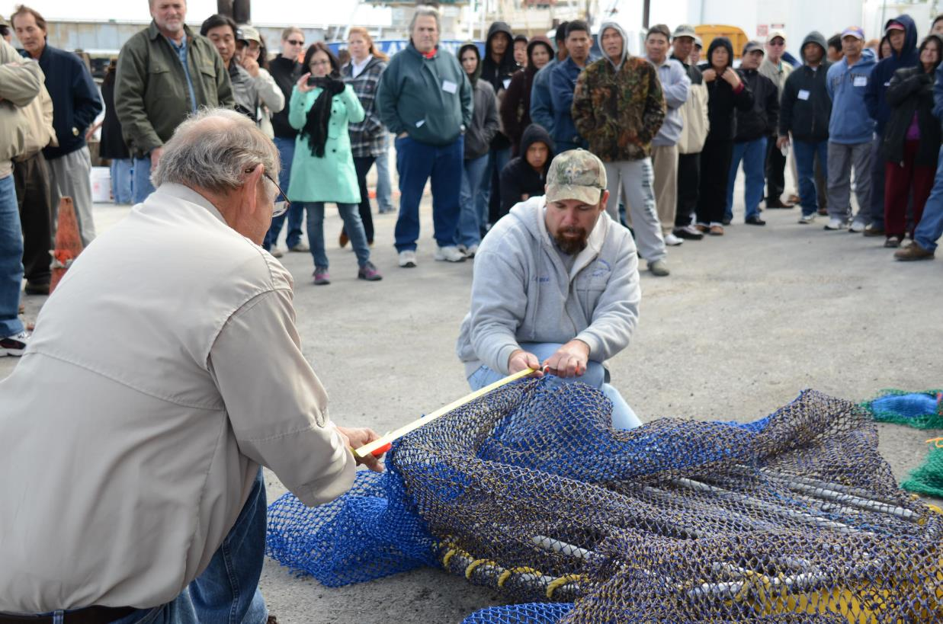


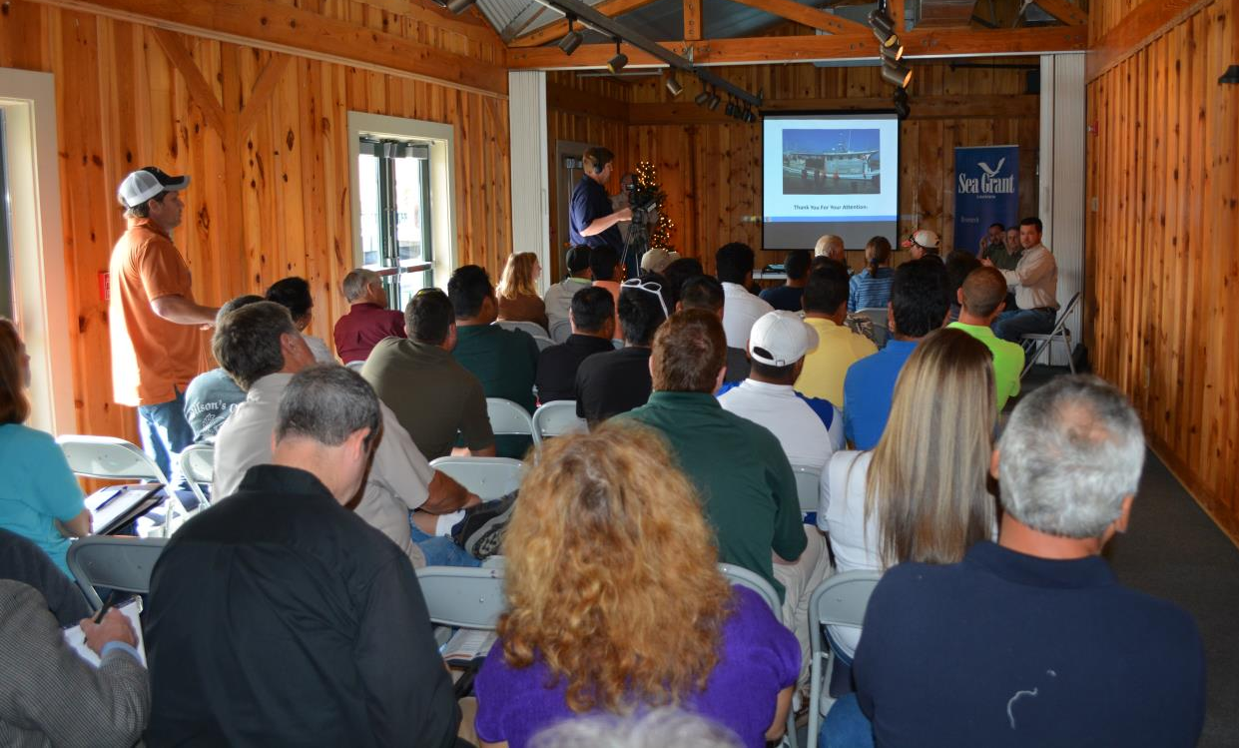
Workshops & Dock Days

Slide 7
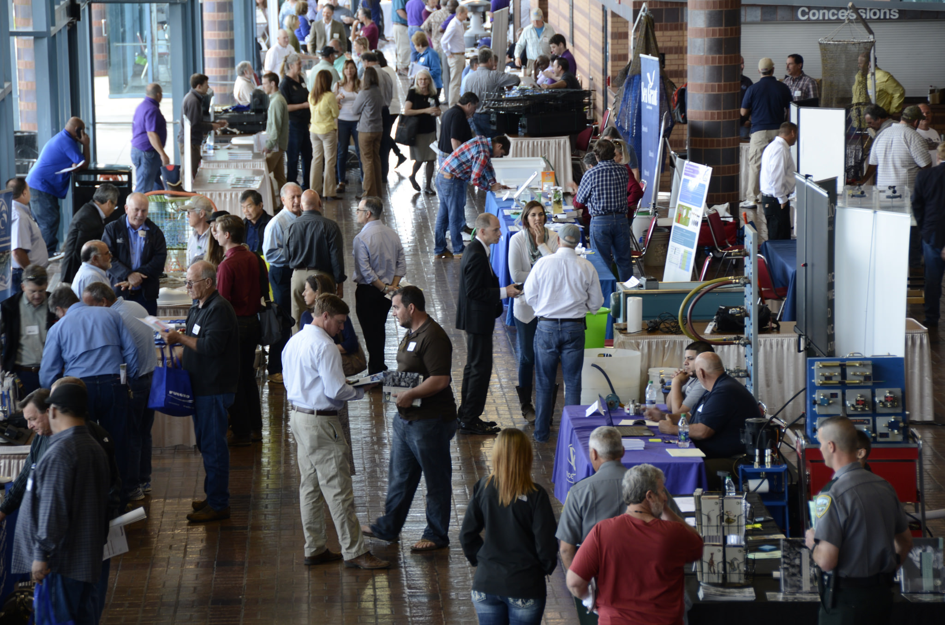
Fisheries Forward Summit
Notes:
Delete image and Place your own picture.

Slide 8
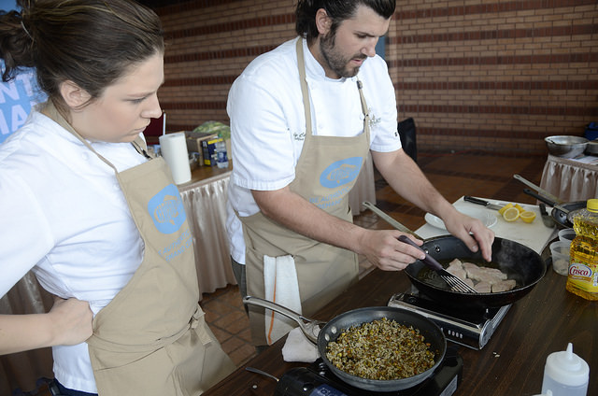
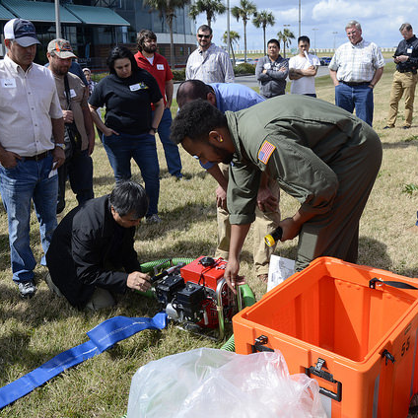
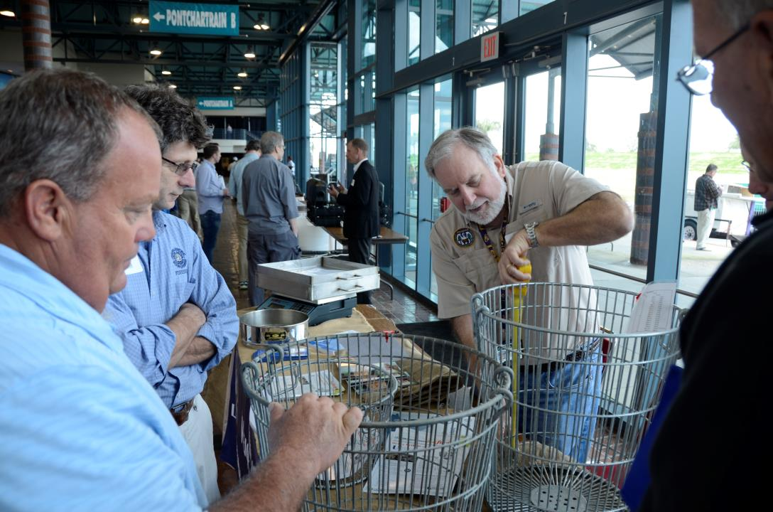
Summit 2018
The Pontchartrain Center, Kenner, LA
2018

Slide 9
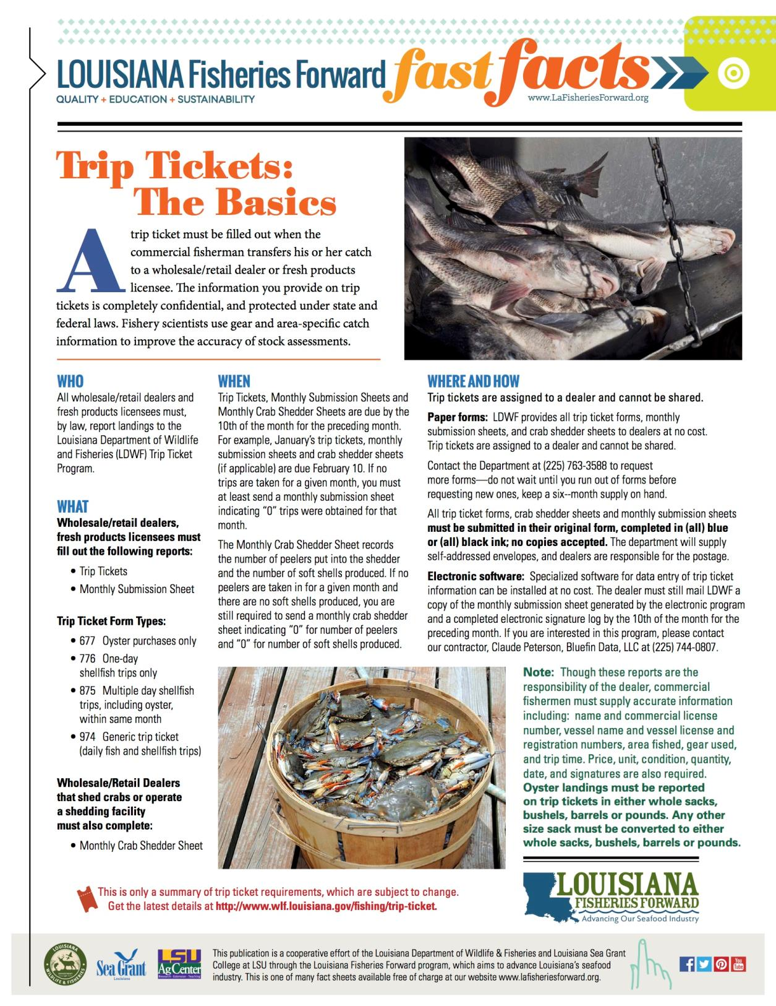
Fast Fact Sheets
Detailed fact sheets that give more information on topics of interest:
Transportation Best Practices
Black Spot Prevention & Alternatives
HACCP Overview
Tax Topics
And More – 17 in all . . .

Slide 10
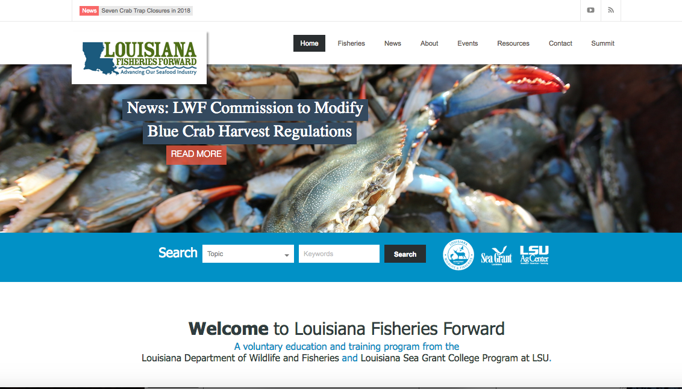

Slide 11
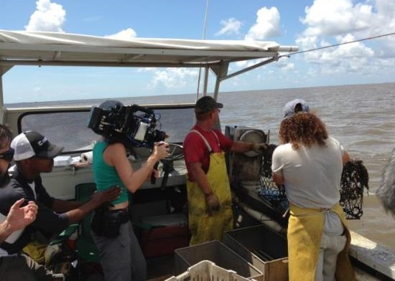
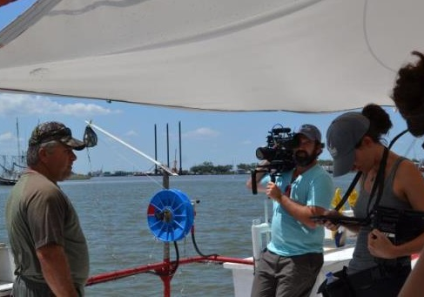
Video Series
A professional film crew went along the coast to capture video of fishermen and processors . . .

Slide 12


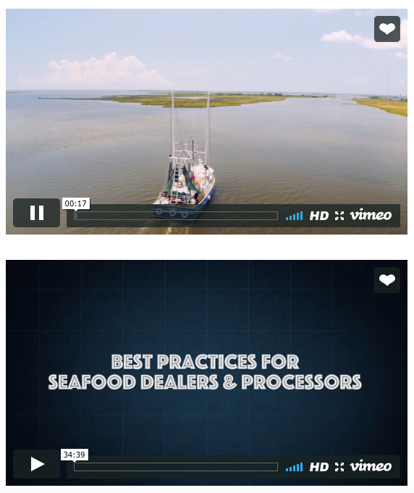
Video Series
  Best Practices for Commercial Fishermen
  Best Practices for Seafood Dealers and Processors
  Best Practices for Commercial Crab Fishermen
  Best Business Practices for the Seafood Industry
  Best Practices for Commercial Shrimpers
  Best Practices for Commercial Oyster Harvesters
  Best Practices for Commercial Saltwater Finfishermen
  Fisheries Management and the Regulatory Process

Slide 13
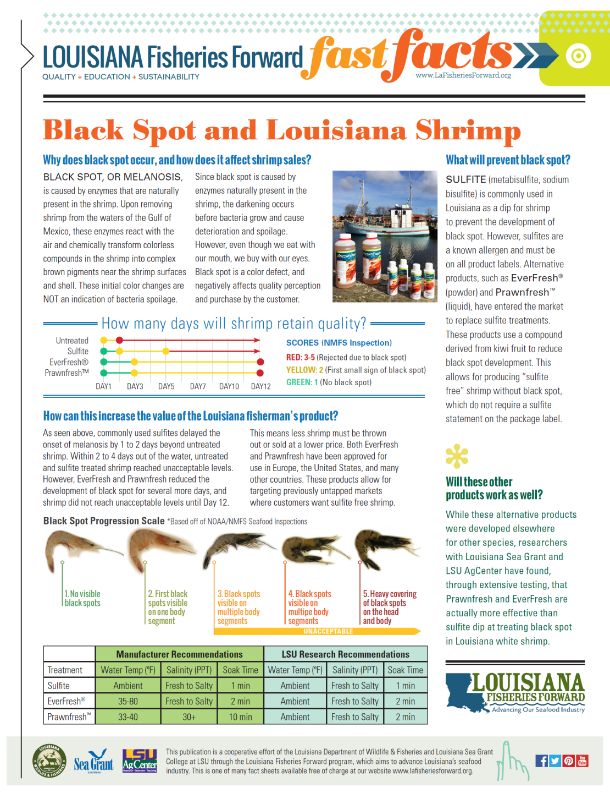
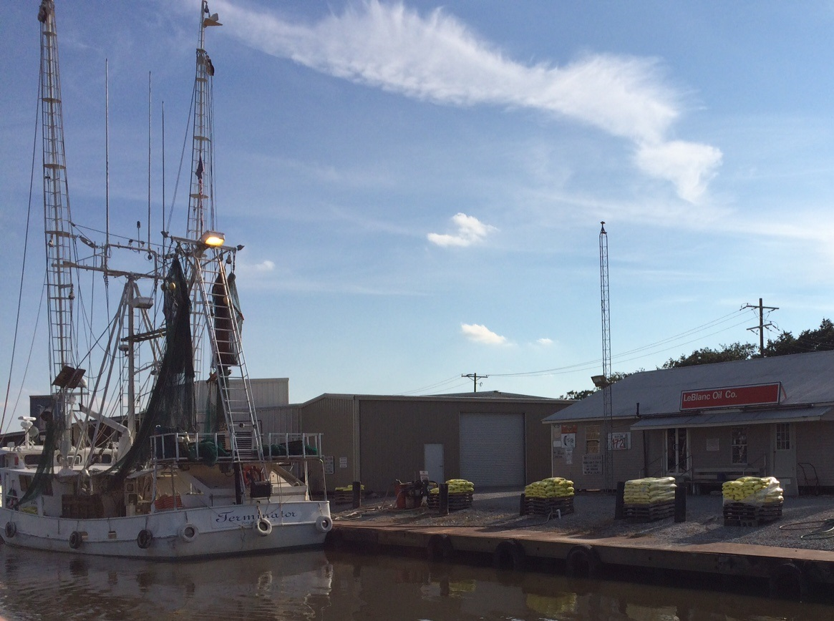
Extension Makes an Impact
Meeting photo if we can find it or cover of pub?
Community involvement:
Steering committee meetings
Student tours of Delcambre
Presentation of Charettes
2007

Slide 14
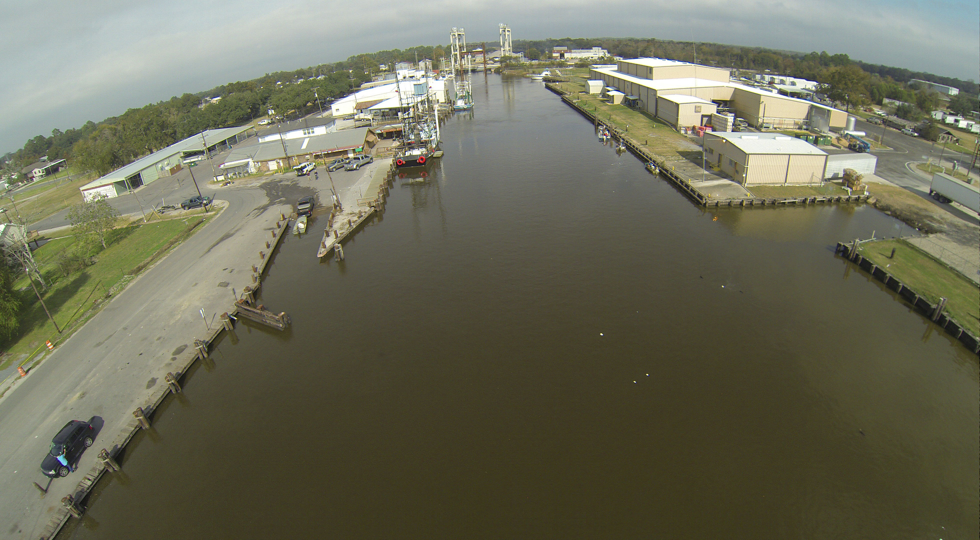
Professionalism is only part of the story to move the industry forward
Notes:
Delete image and Place your own picture.

Slide 15
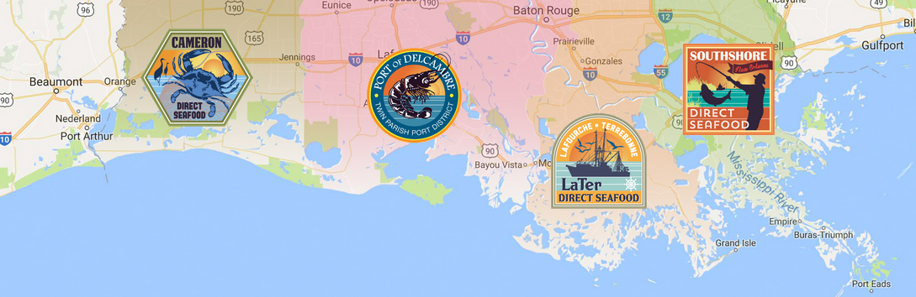


Enter Louisiana Direct Seafood
Overall Goal
Our mission is to help coastal fishermen connect with consumers, and build community support for fresh, wild-caught seafood products.

Slide 16
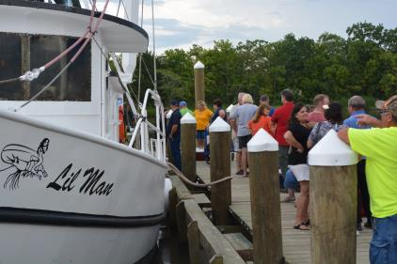
Pieces of the Puzzle
Micro Processing
Quality Improvement
Direct Marketing
Brand Development
Adding value
& creating opportunities

Slide 17
Consumers say….
it is important for them to know they are supporting local fishermen.
Notes:
Delete image and Place your own picture.

Slide 18


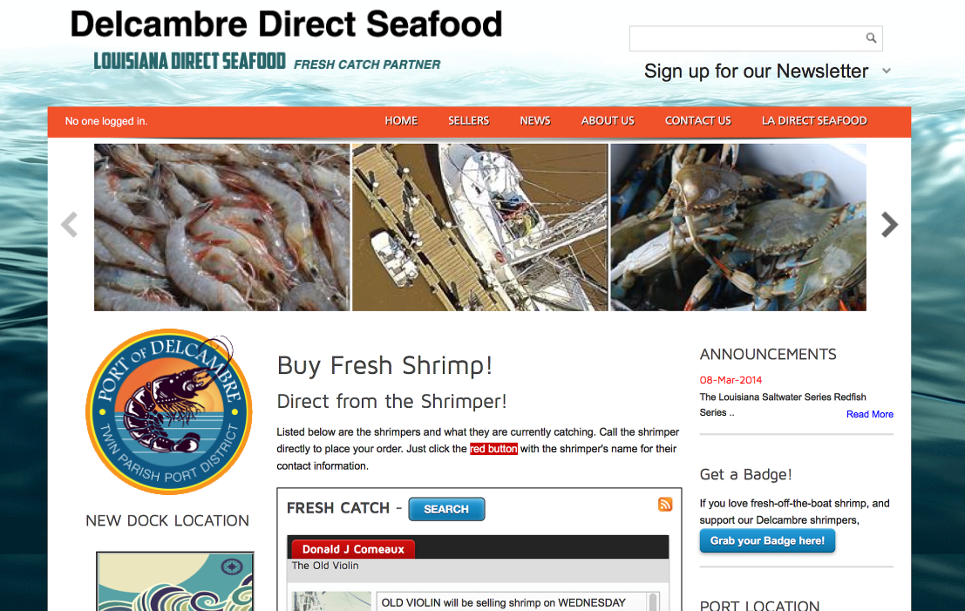
The website that changed it all
DelcambreDirectSeafood.com
2010
Notes:
To change the image behind the Mock up.
Select the layer - > Right Click -> Send to Back -> Delete the image -> Drag & Drop your Own Picture -> Send to Back (again)

Slide 19
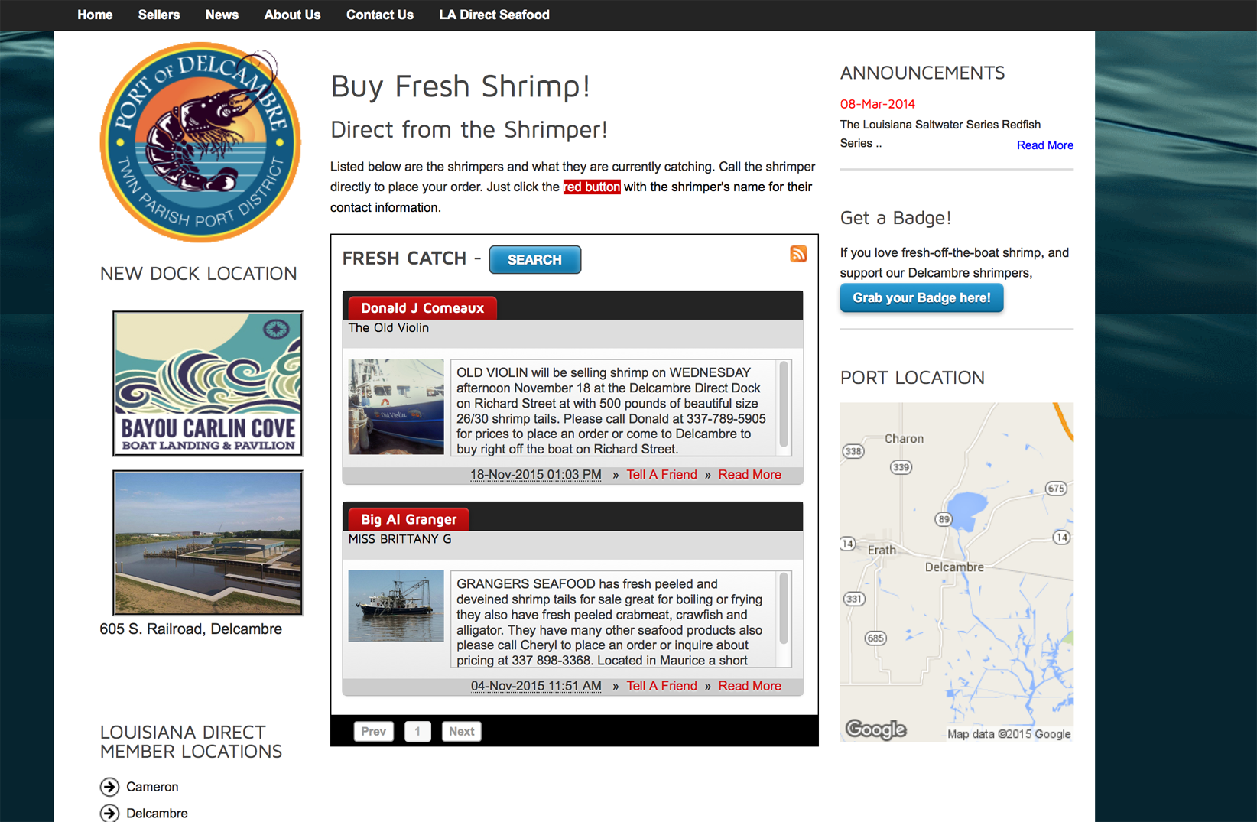
Fresh Catch Message
Fisherman log in to post their latest catch for the public to buy direct.

Slide 20
Impact of Direct Marketing
=
66%
2011
2010
Increased profitability
(from prior year)
30 boats
10 boats

Slide 21
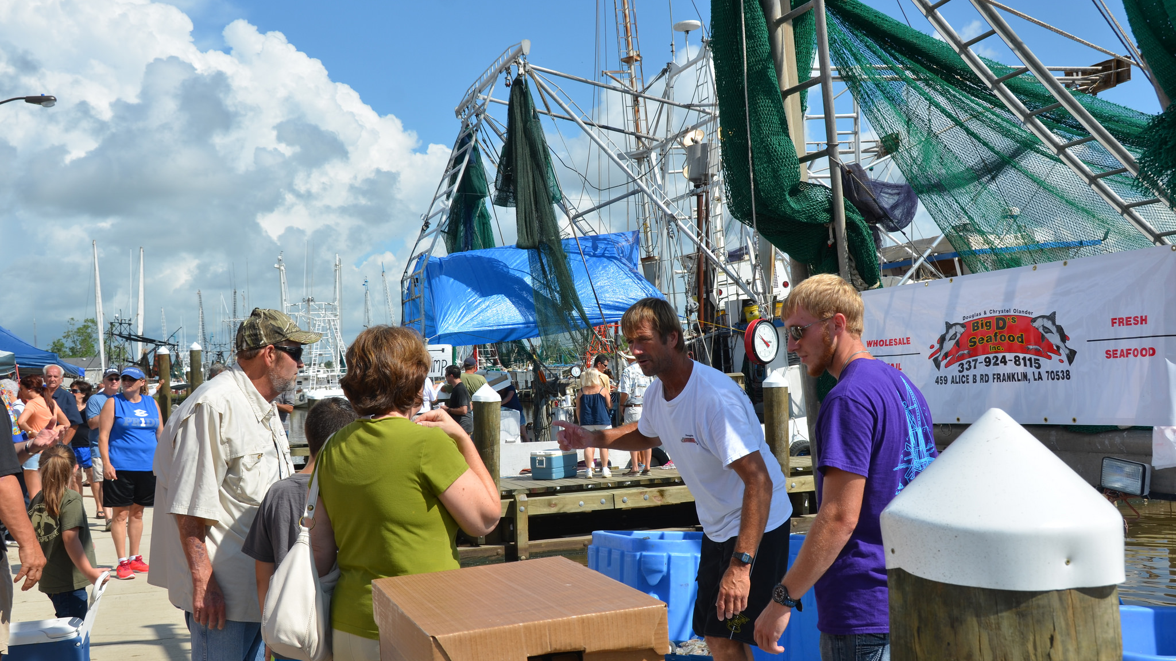
Here we grow
2012
Notes:
Delete image and Place your own picture.

Slide 22
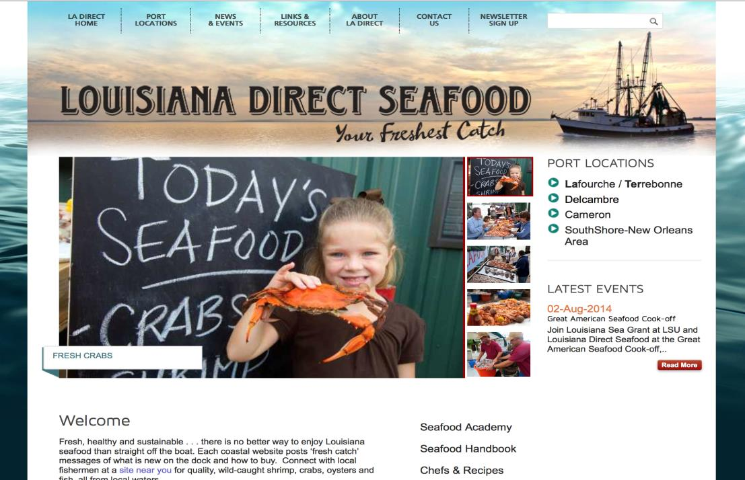
DDS Model expands to
Louisiana Direct Seafood
Notes:
To change the image behind the Mock up.
Select the layer - > Right Click -> Send to Back -> Delete the image -> Drag & Drop your Own Picture -> Send to Back (again)

Slide 24
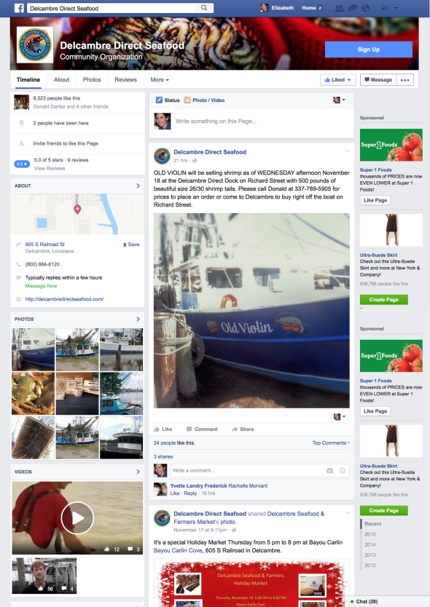
Facebook Launch
Delcambre Direct Seafood leads the other sites, entering the world of Facebook with incredible success.

Slide 25
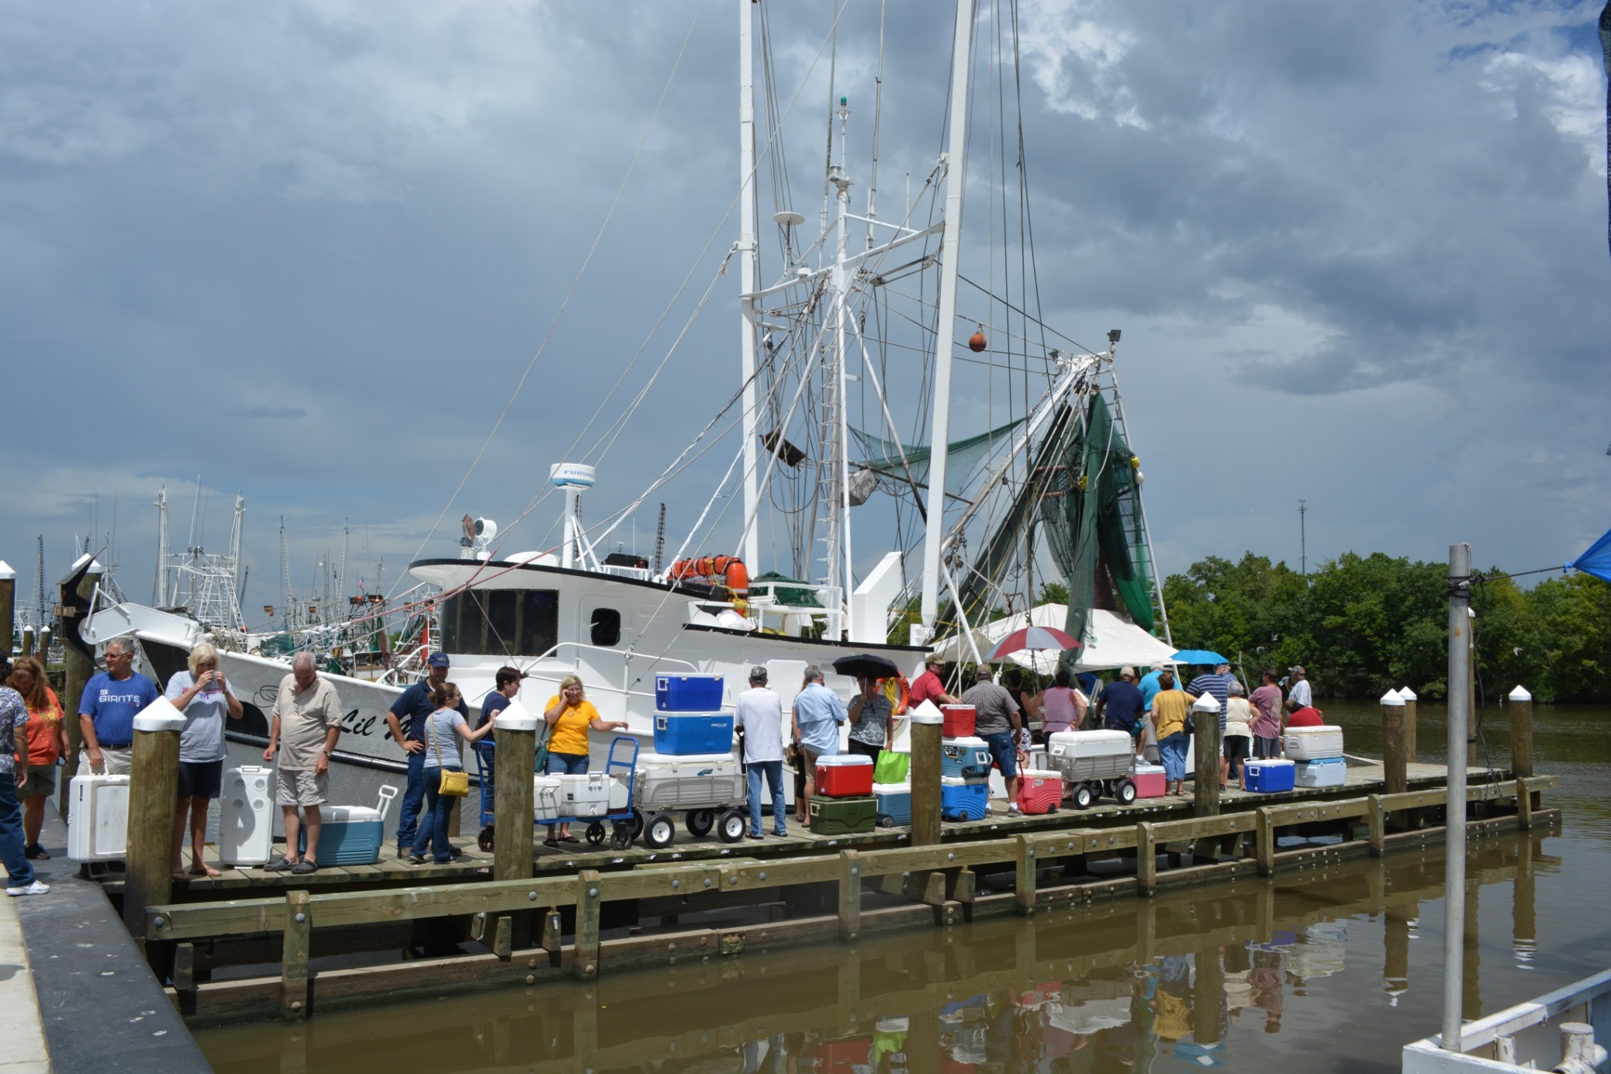

Slide 26
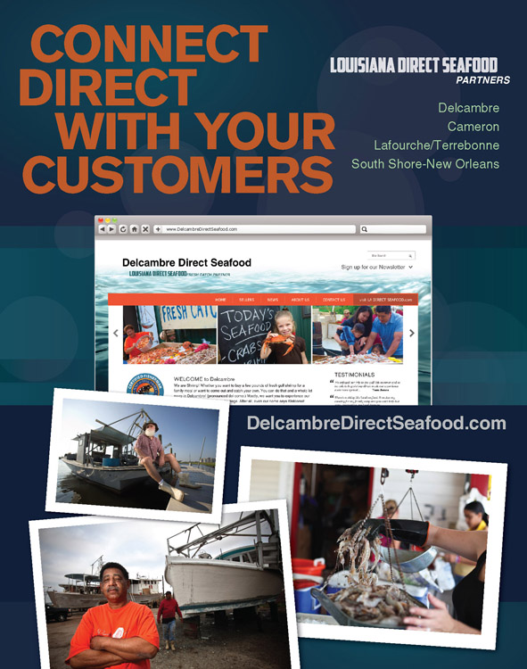
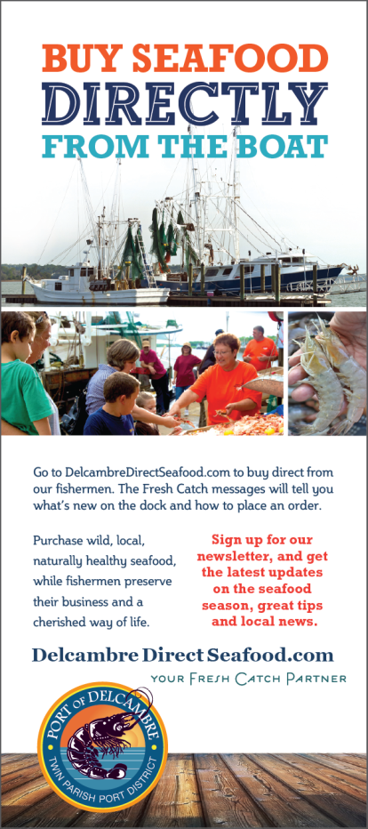
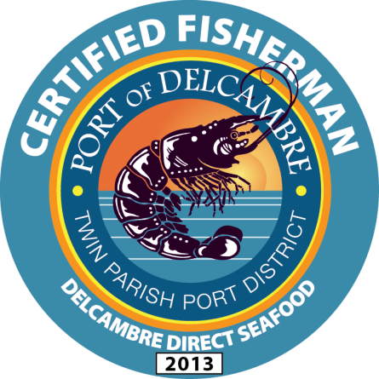
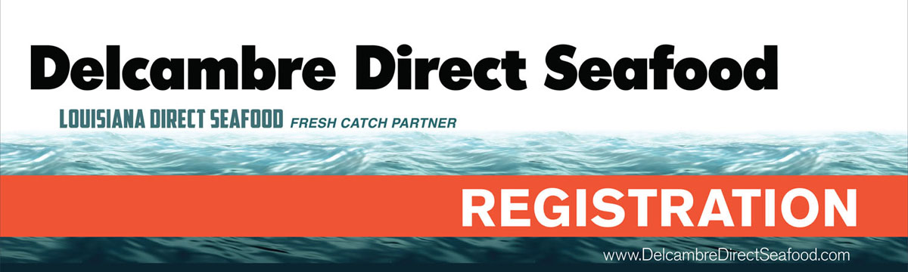

Slide 27
Consumers prefer
local seafood over imports
when they visit the coast,
but they do not know where to find local products in season.
Notes:
Delete image and Place your own picture.

Slide 28
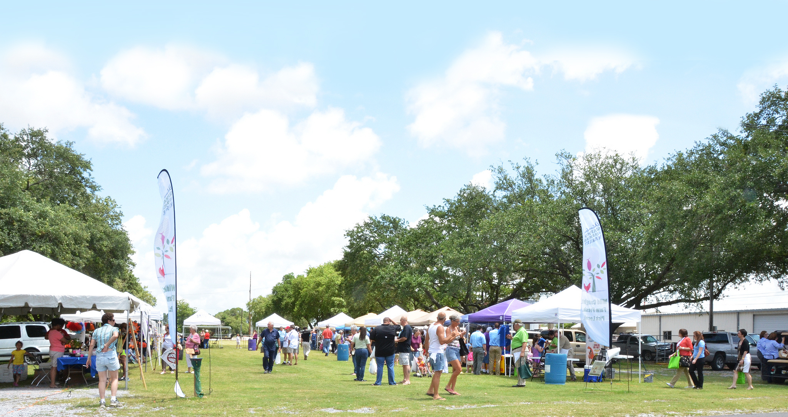
NO LOOKING BACK
Notes:
Drag your picture and Send to Back

Slide 29

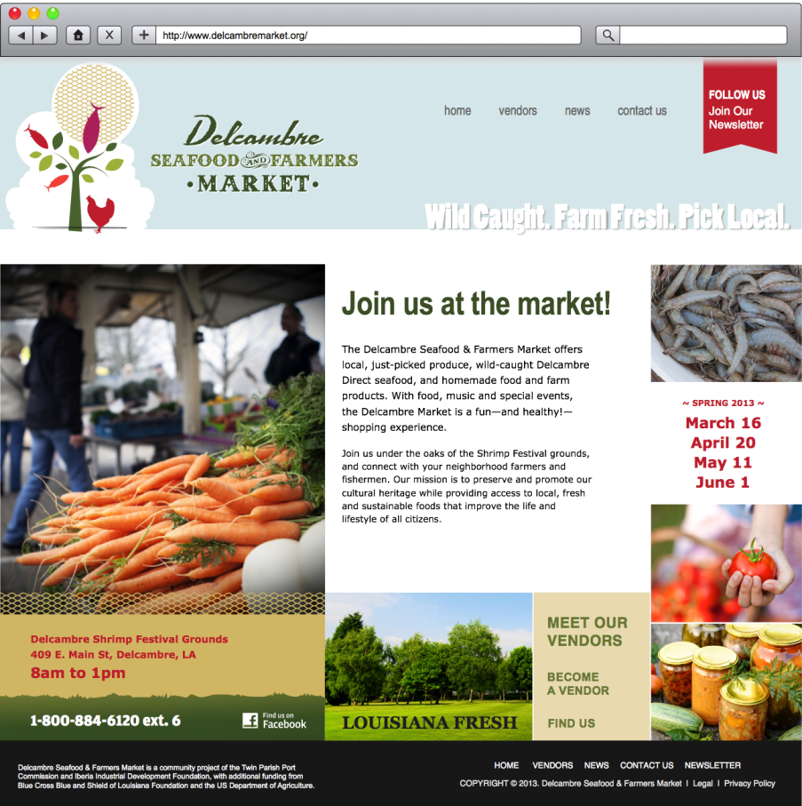
Delcambre Seafood & Farmers Market
Opening day in March brought over 2,000 attendees.

Slide 30
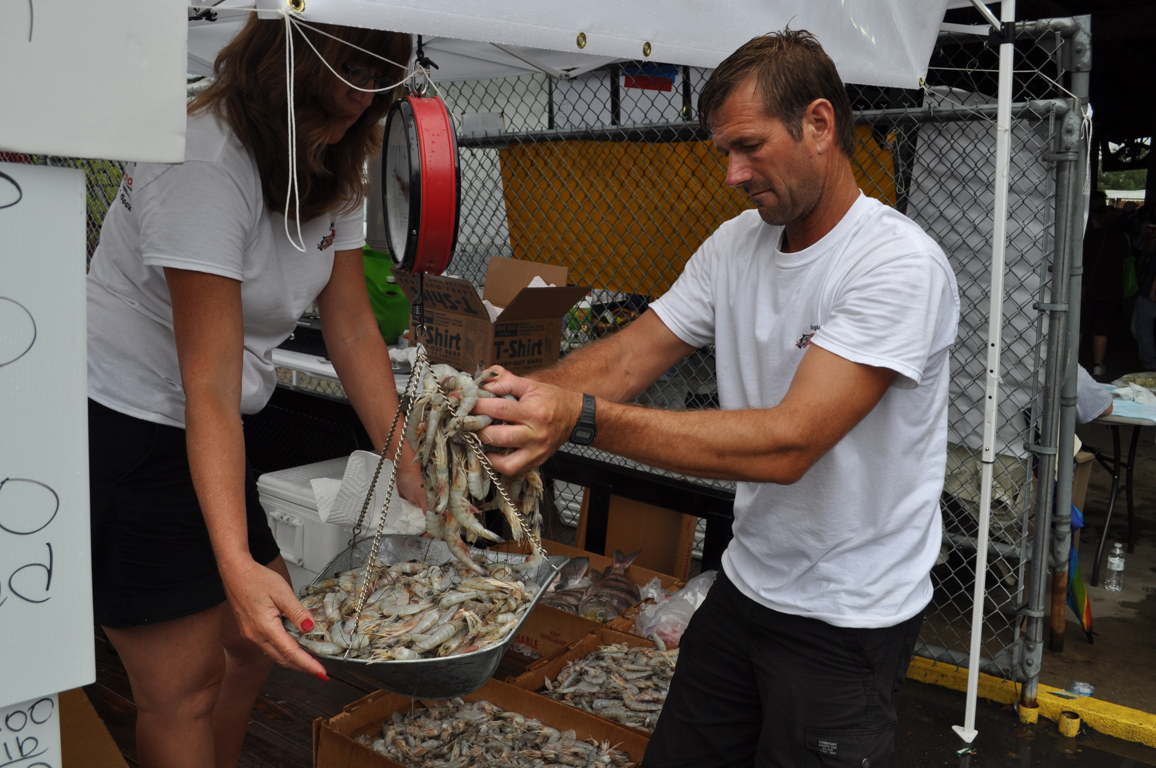

Slide 31
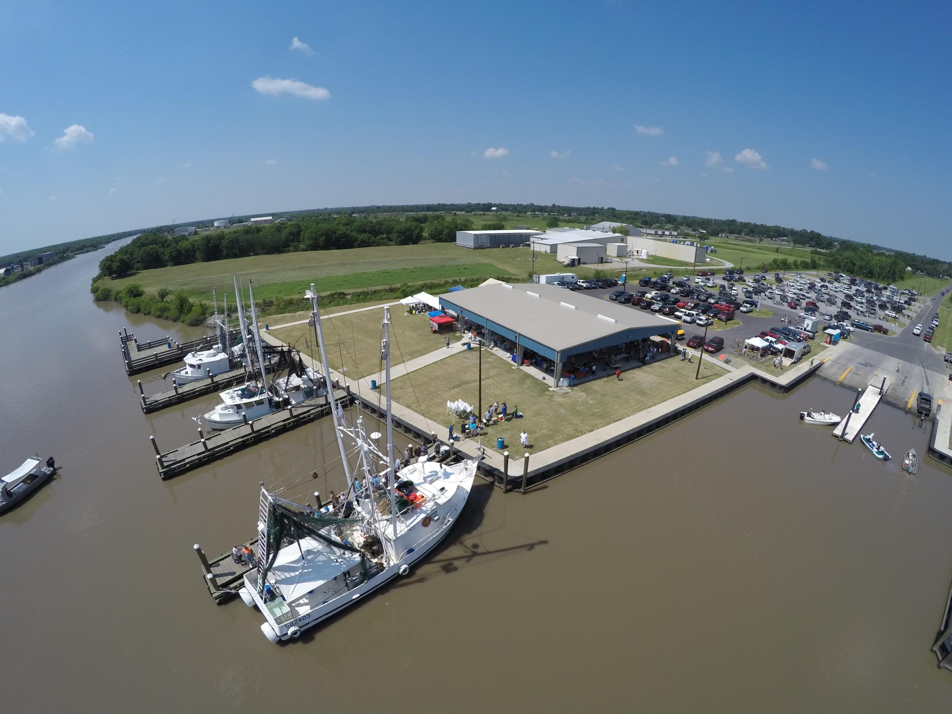

Slide 32
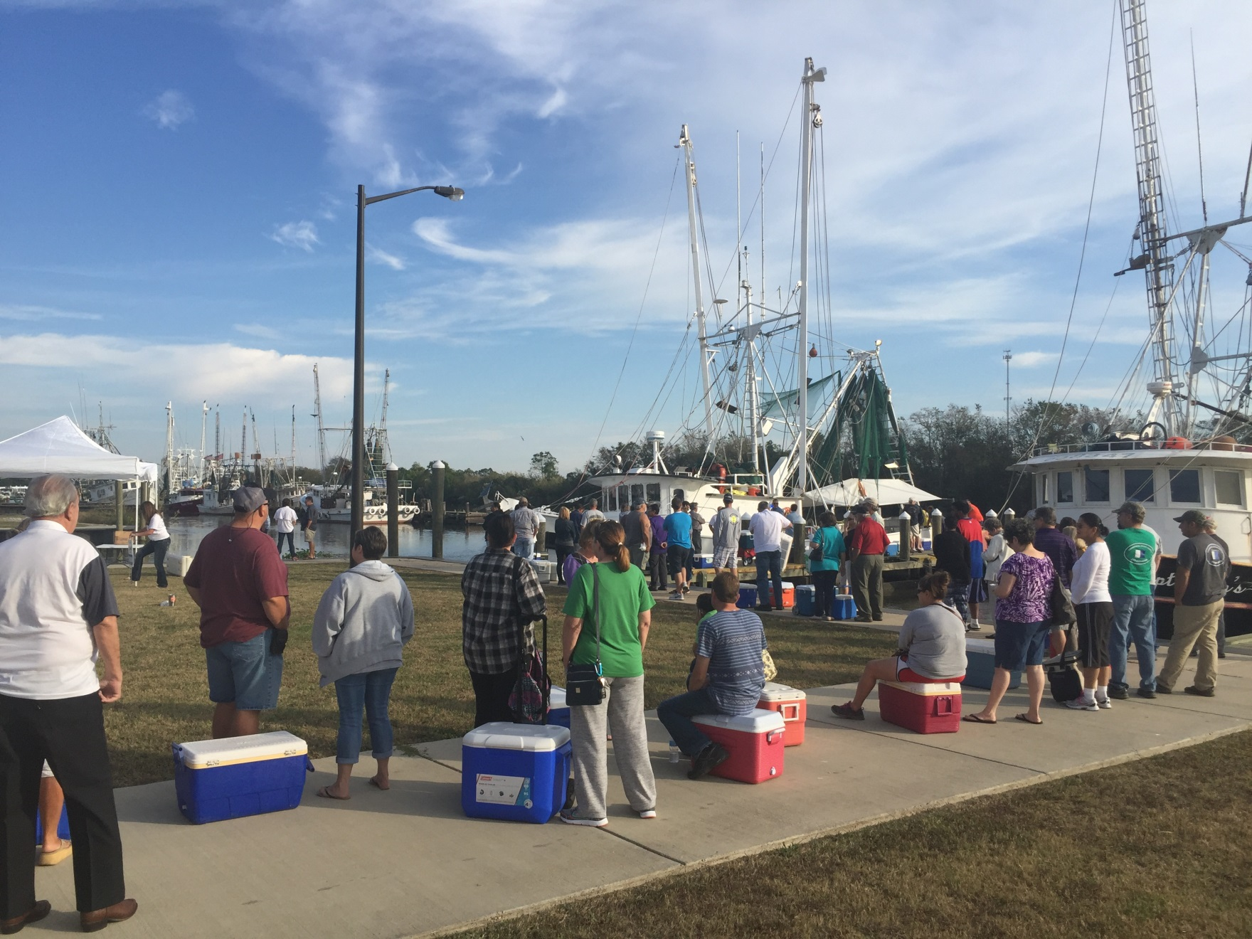

Slide 33
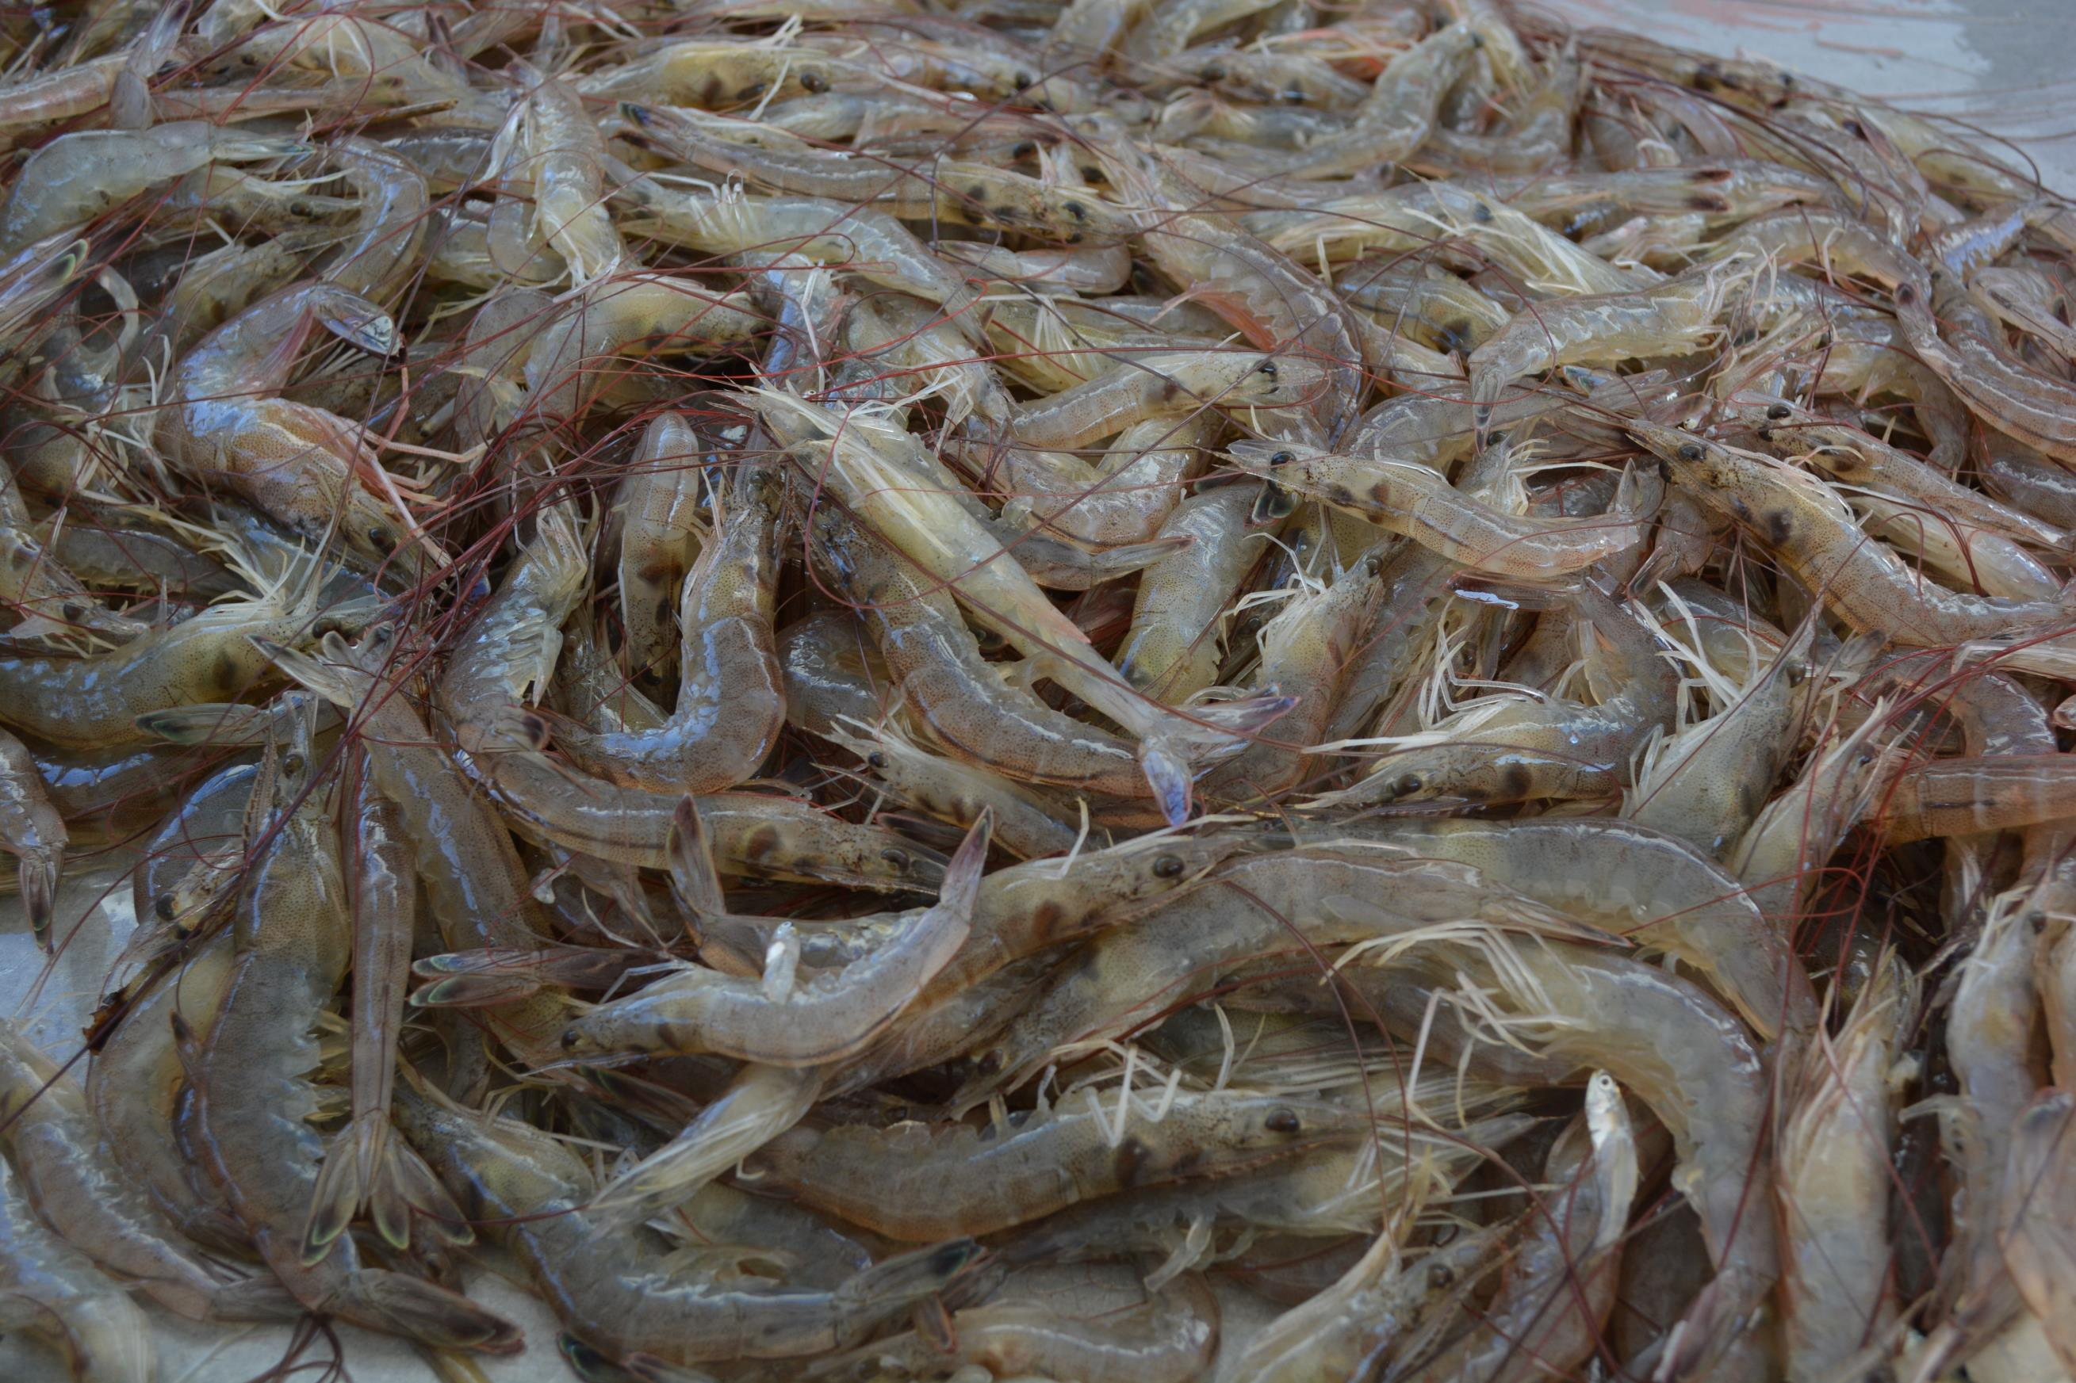
Toward quality improvement

Slide 34
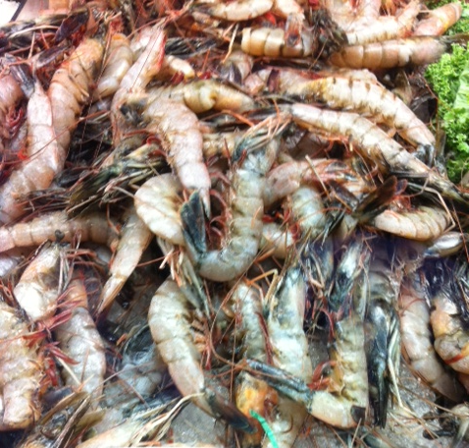
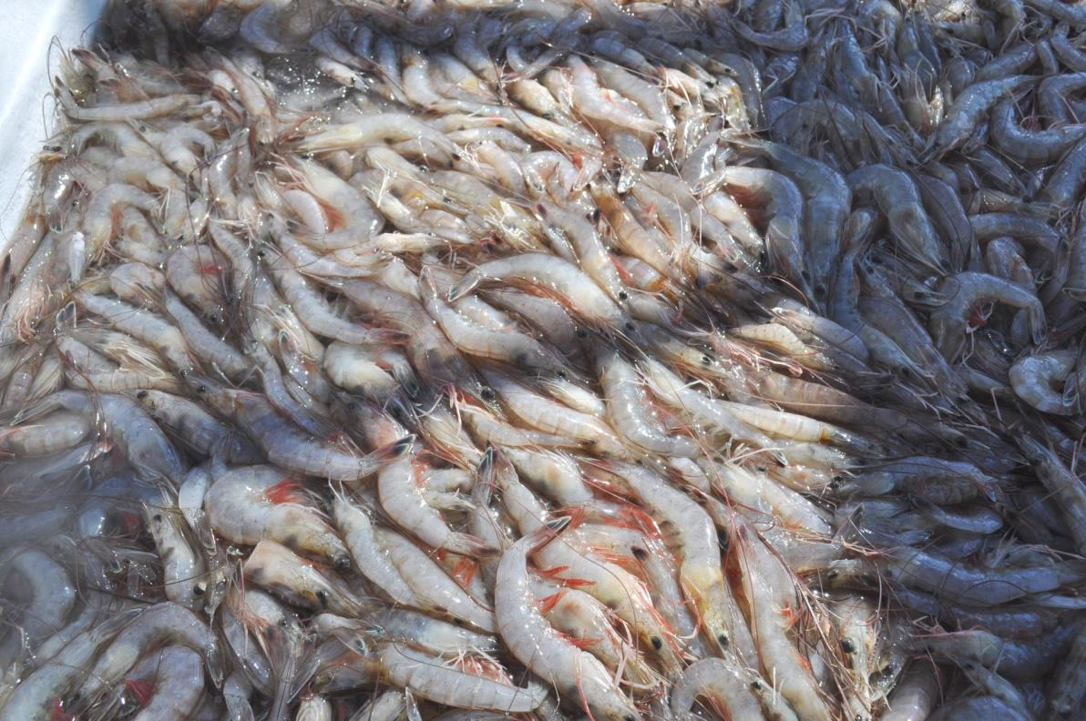
ELIMINATING BLACK SPOT

Slide 35
Education of Fishermen
COLD CHAIN MANAGEMENT
Trip Length
Tow Times
Working Shrimp On Back Deck
Sanitation of Equipment and Vessel
Chilling & Freezing

Slide 36
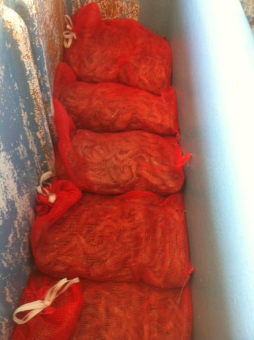
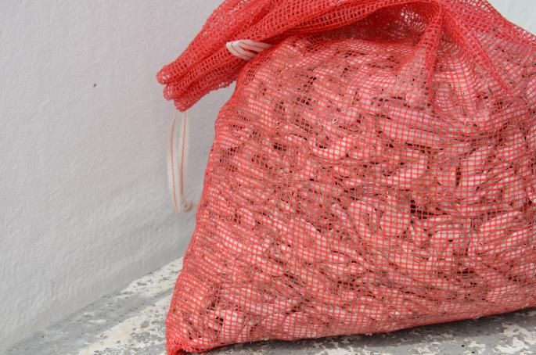
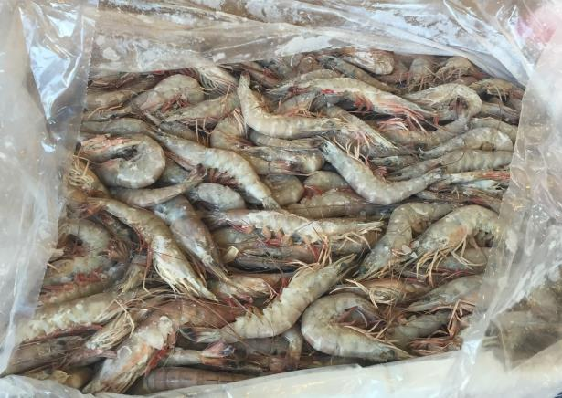
New & Improved Refrigeration Techniques
1
Chilled water system
2
Proper brine freezing so no hot spots
3
Plate freezing, at sea and at the dock

Slide 37
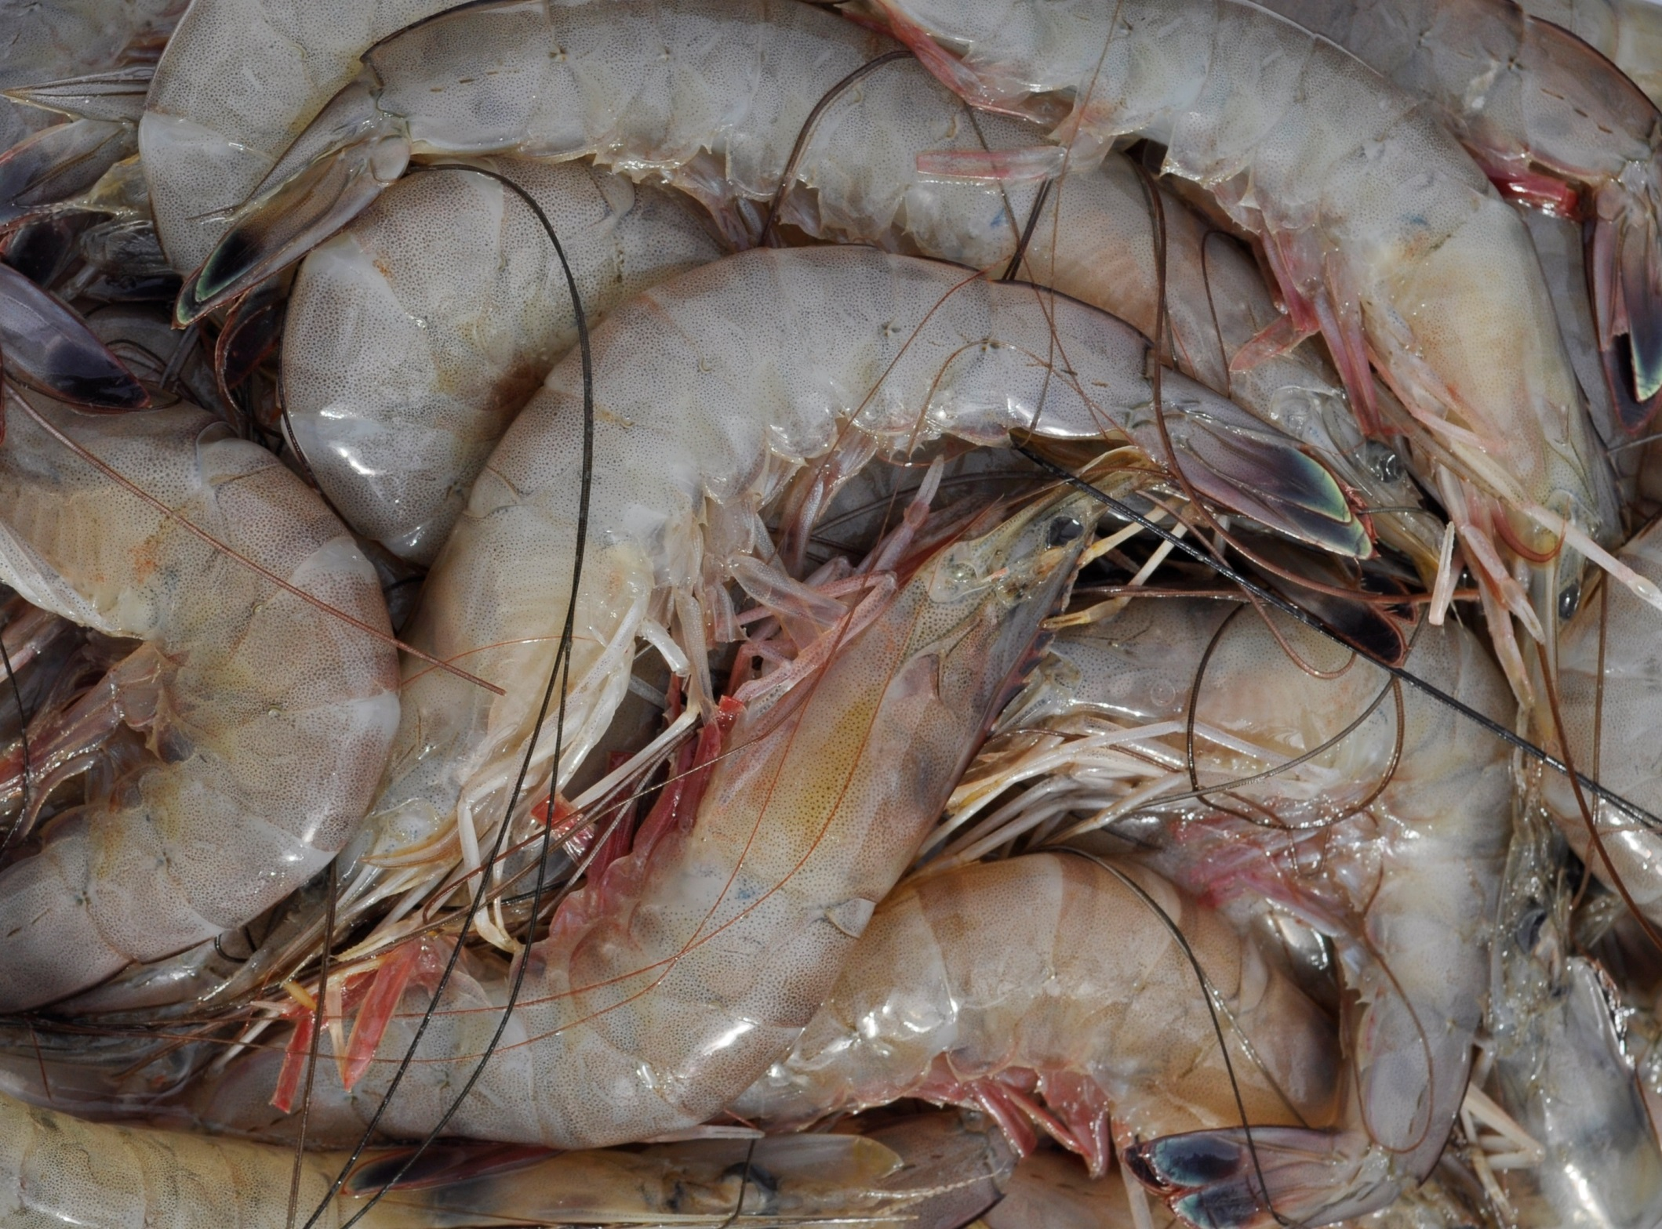

Slide 38
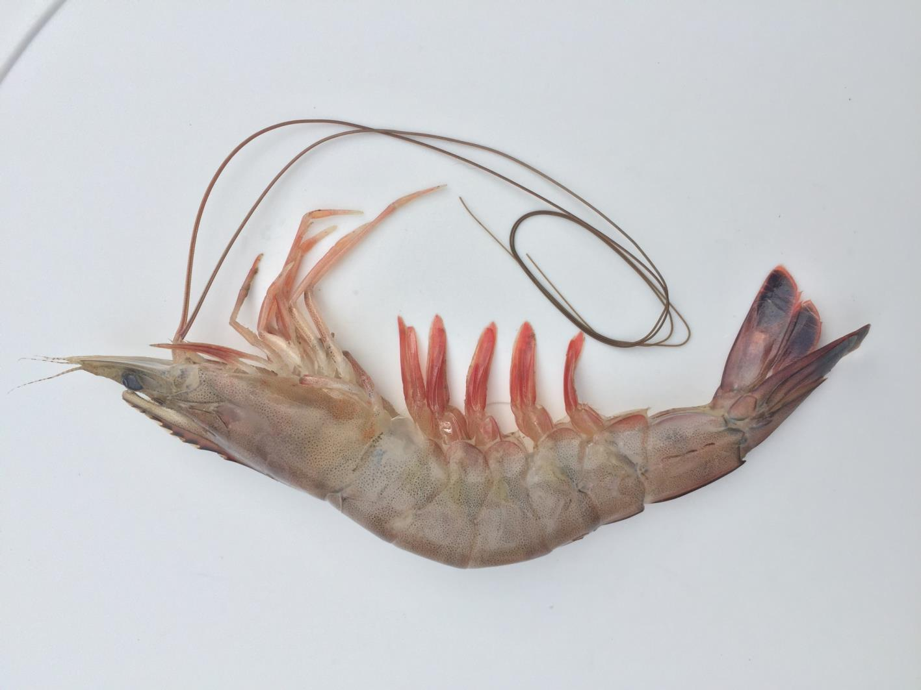

Wild Plate Frozen
Brand and operating procedures in development
Notes:
To change the image behind the Mock up.
Select the layer - > Right Click -> Send to Back -> Delete the image -> Drag & Drop your Own Picture -> Send to Back (again)

Slide 39
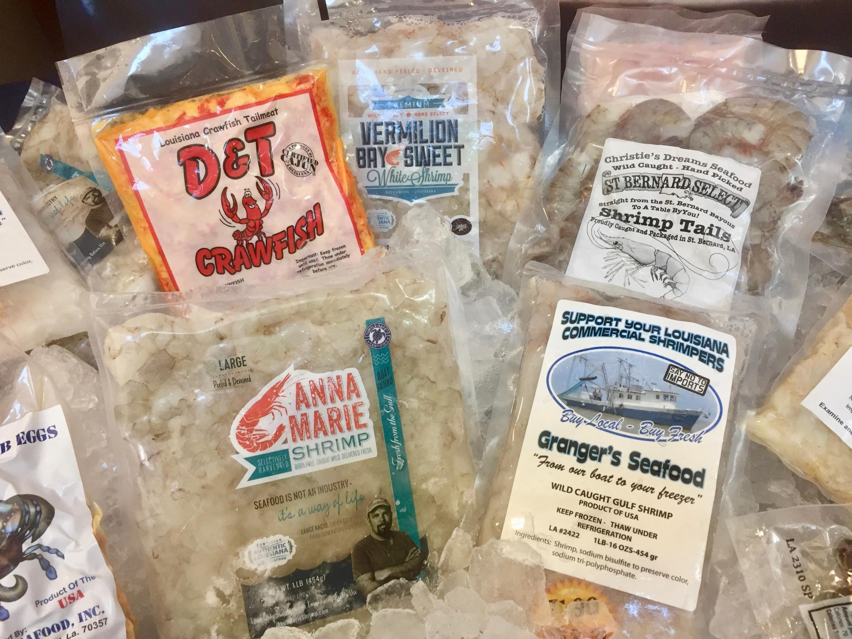
Meeting the rising consumer demand for ready-to-cook, local seafood.
MICRO PROCESSING
Notes:
Drag your picture and Send to Back

Slide 40
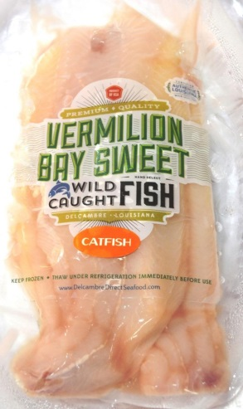
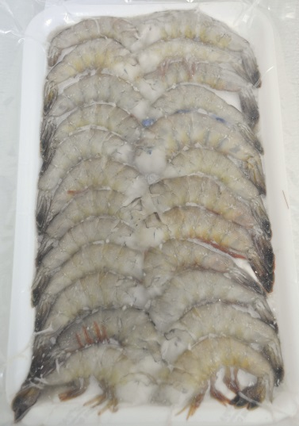







Adding value . . . Creating opportunities

Slide 41



Christie’s Dreams = St. Bernard Select

Slide 42



Big Al & Cheryl Granger = Granger’s Seafood

Slide 43


Prawnto splitter / de-veiner
Vacuum pack machine

Slide 44

Taking Branding to the Next Level

Slide 45
Local Frozen Shrimp Brand Debuts
Pilot project takes selling direct to the next level, in the off season.

Slide 46


At Delcambre
Shrimp Festival
New Iberia
Gumbo Cook-off
The Vermilion Bay Sweet Brand launched officially at the 2012 Delcambre Shrimp Festival . . .
. . . And at the Gumbo Cook-off.
The brand’s positive reception encouraged stakeholders to continue product development.

Slide 47


Slide 48


Vermilion Bay Sweet
Louisiana Seafood Promotion Board Press Conference

Slide 49



Delcambre Media Day
Resiliency Tour
Tour of the Marina and waterfront
Tour of the processor where VBS packed
Debut of the NEW Seafood & Farmers Market

Slide 50
Vermilion Bay Sweet Brands Expanded
To include ‘gumbo’ pack of smaller shrimp, fish and crab

Slide 51


Slide 52


Slide 53

Opportunities
are endless
Notes:
Delete image and Place your own picture.

Slide 54




Slide 55
“
We were successful because we capitalized on our assets . . . as well as market trends like buying local and chem free. With the social media explosion, it was a natural way to reconnect people to local resources. Our success has been overwhelming.”
—Thomas Hymel, Louisiana Sea Grant/LSU AgCenter & Louisiana Direct Seafood program director
Notes:
Delete image and Place your own picture.

Slide 56


